Slide 1
Learning with Virtual Reality 5.0
Team Members: Roger Boza, Jerry Pujals Product Owner: Shahin Vassigh
Instructor: Masoud Sadjadi School of Computing and Information Sciences Florida International University
Final Presentation
Spring 2018
Notes:
7 seconds.( I will select 2 best slides (i will give them extra points and students will present for CIS committee)
Greet your audience, thank them for attending your presentation, introduce yourself, introduce your project, introduce your team members, and quickly indicate what each of you did in a high-level manner, and put more emphasis on your part/contribution.

Slide 2
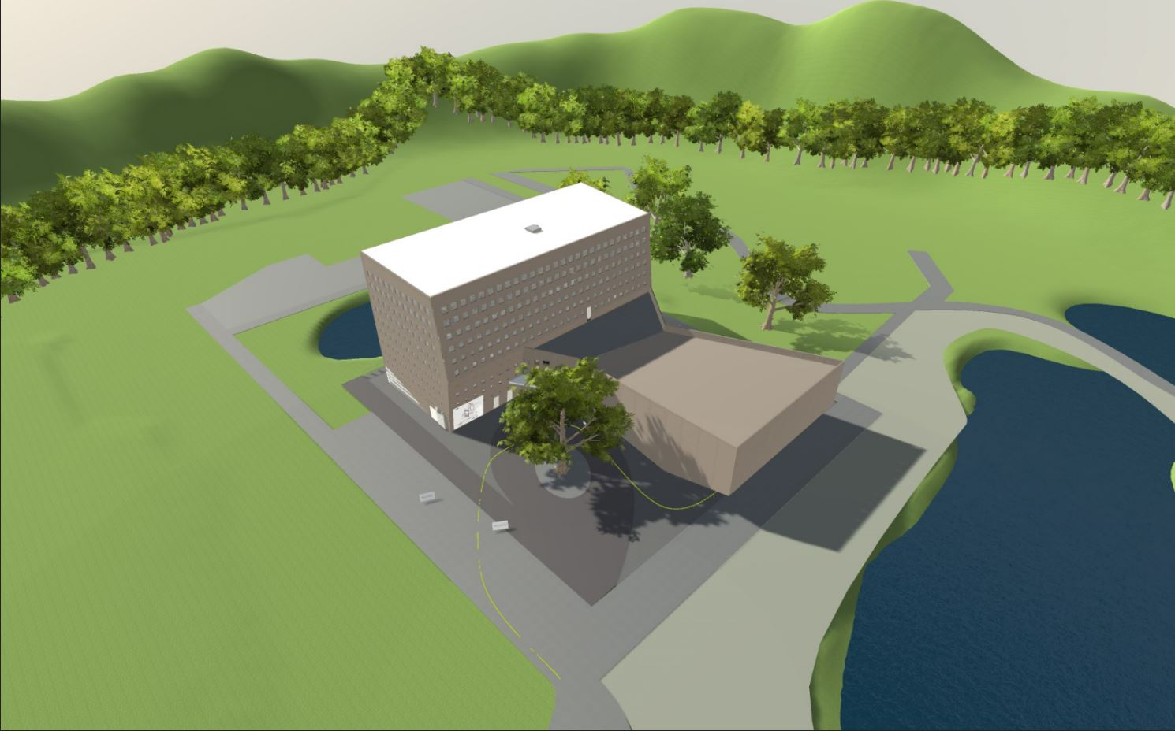
Project definition
Birds eye view of the Open World FIU’s SIPA 3D model building.
Notes:
10 seconds.
Introduce the problem that the whole project (in all versions) tackles with GIF or screenshot.

Slide 3
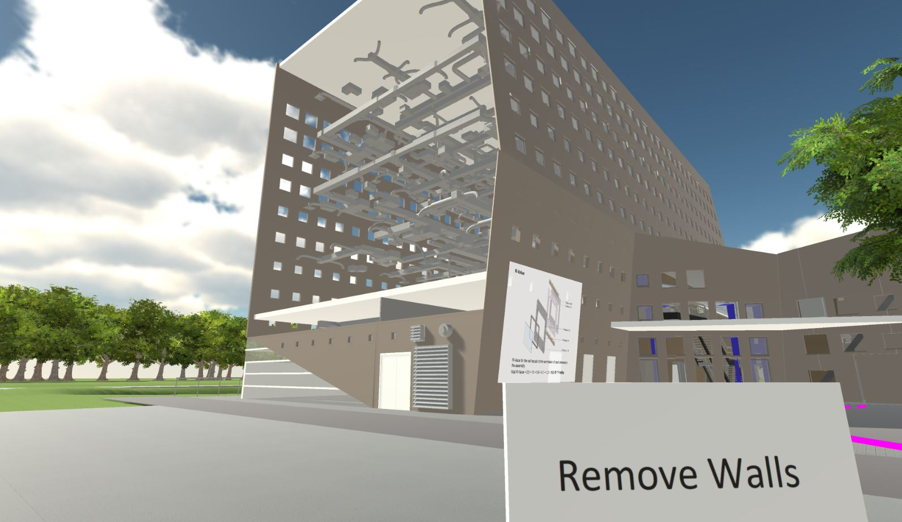
Remove Walls Experience
External wall removed allowing full visibility to the inside structure building.
Notes:
20 seconds.
Introduce the problem that the your project (in new version) tackles with GIF or screenshot.

Slide 4
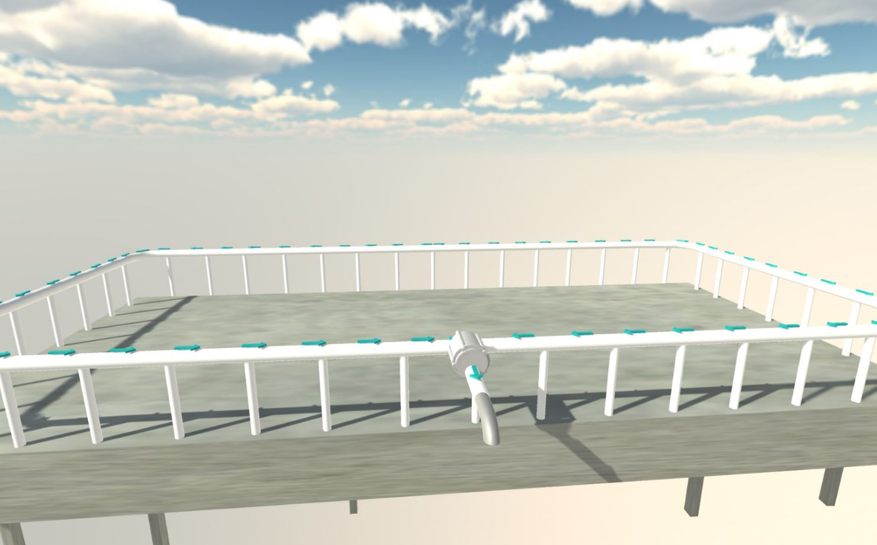
Soil Experience Animation
Movement water in the soil experience animation.
Notes:
20 seconds.
Introduce the problem that the your project (in new version) tackles with GIF or screenshot.

Slide 5
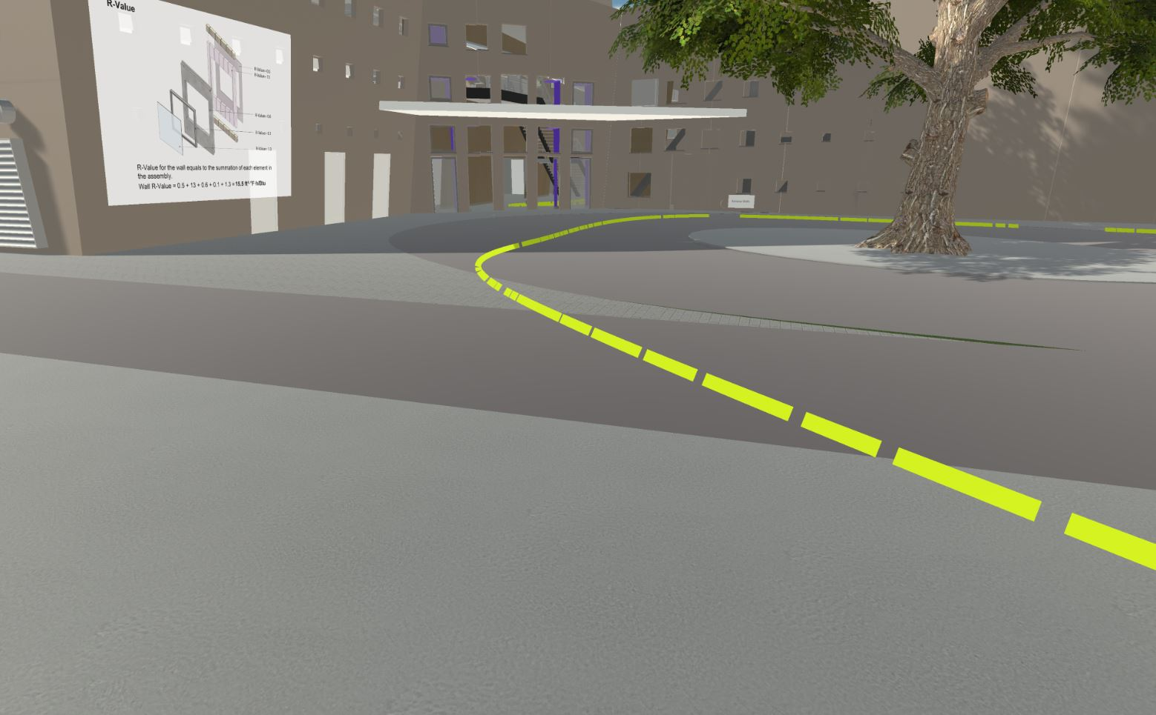
Walkthrough Particle Guidance
Walkthrough particle guidance around the building for the simulation.
Notes:
20 seconds.
Introduce the problem that the your project (in new version) tackles with GIF or screenshot.

Slide 6
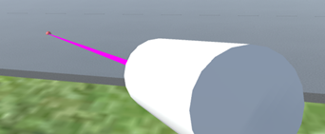

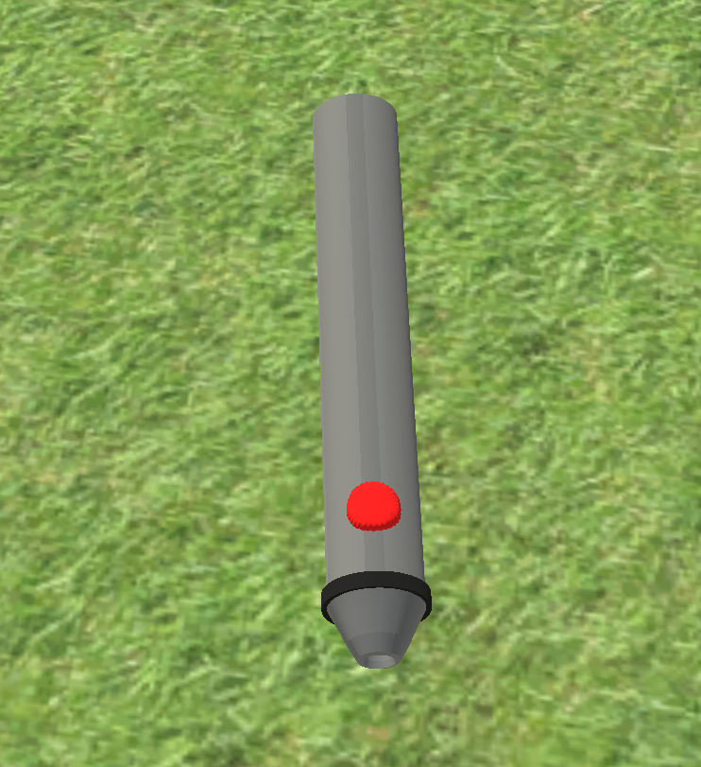
Object Pointer
Old pointer
New pointer
Intuitively
Notes:
20 seconds.
Introduce the problem that the your project (in new version) tackles with GIF or screenshot.

Slide 7
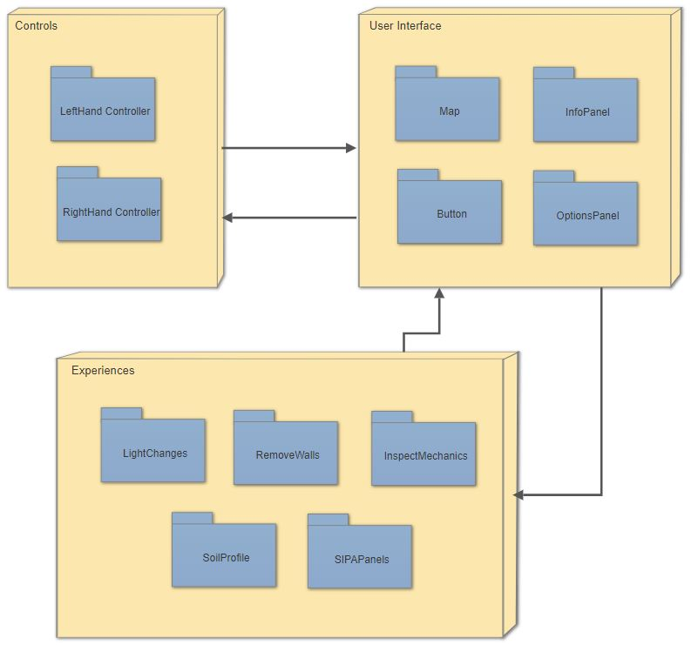
System Design: Architecture
Notes:
20 seconds
System design: Highlight the parts that you contributed to them.
1. System decomposition; identify the architecture patterns used
2. System deployment – h/w and s/w requirements

Slide 8
User Stories
User Story #314 – Fix lighting inside SIPA building
User Story #315 – Fix path guidance texture
User Story #316 – Correct the pivot point of the camera
User Story #320 – Fix Soil Experience
User Story #324 – Remove wall to see elevator
User Story #330 – Change pointer model
Notes:
5 seconds.
List the user stories that you worked on them.(put in order of importance). Stay focused on the parts that you have been working.

Slide 9
User Story #314
Fix lighting inside SIPA building
As a user, I want to have correct lighting inside the building so that I can see the 3D model.
Acceptance Criteria:
Internal structure of SIPA building visible.
Notes:
60 seconds
The tile of user story
The most important user story you worked on it. You have to describe this one very well and be proud of that.
Please present and show the complexity of your work, code, algorithms, and technical challenges and technologies you have used. (you could use screenshot if you want. Visual presentations are better than text presentation)
Go into the details of the most important/significant tasks using bullet lists or visual graphs or state chart diagram
Sequence Diagram for this user story is mandatory (in another separate page if required)
Demo using screenshots or GIF (in another separate page if required)

Slide 10
User Story #315
Fix path guidance texture
As a user, I want to see correctly the path guideline so that I can follow the interactive model.
Acceptance Criteria:
The path guideline displays a texture.
Notes:
60 seconds
The tile of user story
The most important user story you worked on it. You have to describe this one very well and be proud of that.
Please present and show the complexity of your work, code, algorithms, and technical challenges and technologies you have used. (you could use screenshot if you want. Visual presentations are better than text presentation)
Go into the details of the most important/significant tasks using bullet lists or visual graphs or state chart diagram
Sequence Diagram for this user story is mandatory (in another separate page if required)
Demo using screenshots or GIF (in another separate page if required)

Slide 11
User Story #316
Correct the pivot point of the camera
As a user, I want the camera to rotate around a center point on the head so that the model rotates relative to myself.
Acceptance Criteria:
The model rotates from the perspective of the user.
Notes:
60 seconds
The tile of user story
The most important user story you worked on it. You have to describe this one very well and be proud of that.
Please present and show the complexity of your work, code, algorithms, and technical challenges and technologies you have used. (you could use screenshot if you want. Visual presentations are better than text presentation)
Go into the details of the most important/significant tasks using bullet lists or visual graphs or state chart diagram
Sequence Diagram for this user story is mandatory (in another separate page if required)
Demo using screenshots or GIF (in another separate page if required)

Slide 12
User Story #323
Fix soil experience
As a user, I want to see the soil on the building model so that I can see the how it looks.
Acceptance Criteria:
Side of building is not transparent.
Soil is displayed.
Notes:
60 seconds
The tile of user story
The most important user story you worked on it. You have to describe this one very well and be proud of that.
Please present and show the complexity of your work, code, algorithms, and technical challenges and technologies you have used. (you could use screenshot if you want. Visual presentations are better than text presentation)
Go into the details of the most important/significant tasks using bullet lists or visual graphs or state chart diagram
Sequence Diagram for this user story is mandatory (in another separate page if required)
Demo using screenshots or GIF (in another separate page if required)

Slide 13
User Story #324
Remove wall to see elevator
As a user, I want the walls to be removed so that I can see the elevator.
Acceptance Criteria:
Elevator is visible.
Notes:
60 seconds
The tile of user story
The most important user story you worked on it. You have to describe this one very well and be proud of that.
Please present and show the complexity of your work, code, algorithms, and technical challenges and technologies you have used. (you could use screenshot if you want. Visual presentations are better than text presentation)
Go into the details of the most important/significant tasks using bullet lists or visual graphs or state chart diagram
Sequence Diagram for this user story is mandatory (in another separate page if required)
Demo using screenshots or GIF (in another separate page if required)

Slide 14
User Story #330
Change pointer model
As a user, I want to be able to use an intuitive object model pointer.
Acceptance Criteria:
New object pointer model loads.
Object pointer model is easily usable.
Notes:
60 seconds
The tile of user story
The most important user story you worked on it. You have to describe this one very well and be proud of that.
Please present and show the complexity of your work, code, algorithms, and technical challenges and technologies you have used. (you could use screenshot if you want. Visual presentations are better than text presentation)
Go into the details of the most important/significant tasks using bullet lists or visual graphs or state chart diagram
Sequence Diagram for this user story is mandatory (in another separate page if required)
Demo using screenshots or GIF (in another separate page if required)

Slide 15
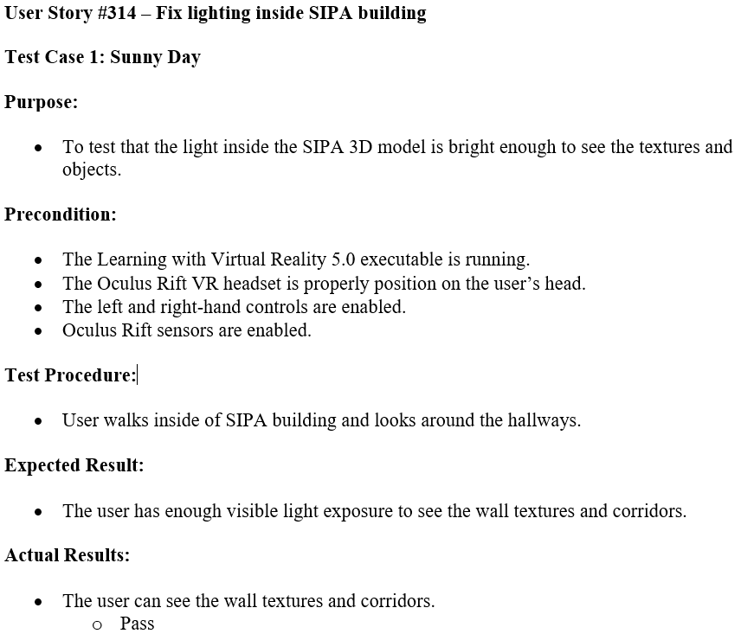
Example Test Case #1
Notes:
10 seconds
A description of verification process and Test Suites and Test Cases for one of the use cases.
1 One sunny day and one rainy day for the implemented use cases (one or more slides).
2 Automated test scripts for the implemented use cases (if any) (one or more slides).

Slide 16
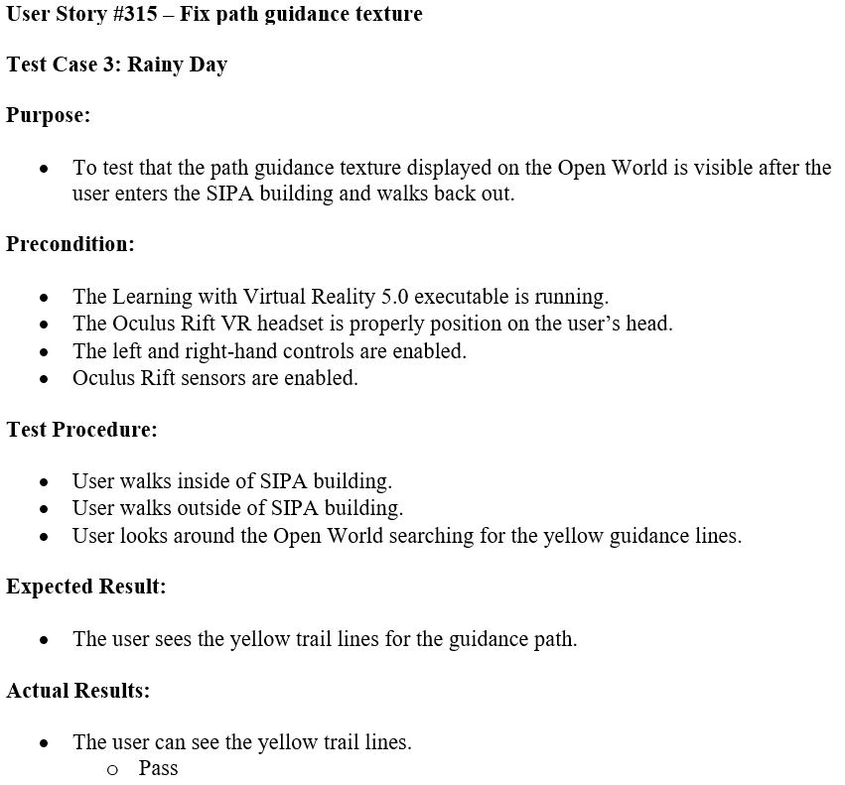
Example Test Case #2
Notes:
10 seconds
A description of verification process and Test Suites and Test Cases for one of the use cases.
1 One sunny day and one rainy day for the implemented use cases (one or more slides).
2 Automated test scripts for the implemented use cases (if any) (one or more slides).

Slide 17
Summary
Multiple experiences for the users to interact with.
Easy to follow walkthrough particle guidance system.
Accurate lighting and ambient illumination.
Intuitive object pointer model.
Optimized SIPA building for faster rendering.
Architectural information displayed for SIPA building.
Notes:
10 seconds
Summarize your contribution, mention your effort for Scrum, Mingle, Github, Google Drive Documentation and minutes
Include your contact information
Ask if anyone has any questions for you.
Thank your audience

Slide 18

Contact Information
Roger Boza
Phone : (786) 359-5682
Email : rboza005@fiu.edu
Jerry Pujals
Phone : (305) 905-2666
Email : jpuja002@fiu.edu
Notes:
10 seconds
Summarize your contribution, mention your effort for Scrum, Mingle, Github, Google Drive Documentation and minutes
Include your contact information
Ask if anyone has any questions for you.
Thank your audience

Slide 19

Q&A
Notes:
10 seconds
Summarize your contribution, mention your effort for Scrum, Mingle, Github, Google Drive Documentation and minutes
Include your contact information
Ask if anyone has any questions for you.
Thank your audience

Slide 20








Technologies
Notes:
10 seconds
Summarize your contribution, mention your effort for Scrum, Mingle, Github, Google Drive Documentation and minutes
Include your contact information
Ask if anyone has any questions for you.
Thank your audience

Slide 21


Notes:
10 seconds
Summarize your contribution, mention your effort for Scrum, Mingle, Github, Google Drive Documentation and minutes
Include your contact information
Ask if anyone has any questions for you.
Thank your audience

